Slide 1
Making a Switch
Overcoming Barriers to Change
Becky Querido | Mar. 21, 2023
Notes:
THANK YOU
INTRODUCE SELF
LAND ACKNOWLEDGEMENT

Slide 2
Learning Objectives
By the end of the session, you will:
Learn why change fatigue is so constant today in the workplace
1
Explore some of the neurological reasons why change is hard
2
Reflect on ways you can switch your thinking and actions to break through barriers to change
3
Develop some actions to take in your own life to navigate constant change
4
Notes:
YEAR OF RE-INVIGORATION
If you are an ACMP member you may know that the board this year has chosen as our theme ‘re-invigoration’
I hope that this offers you a chance as change practitioners to STEP AWAY from thinking about the change OTHERS need to make
And INVITE in some REFLECTION on the changes you need to REINVIGORATE yourself
We have a jam packed hour so I’m going to get right into it
We have so much to cover so we won’t have a lot of time for Q&A at the end
I wanted to create as much room as possible for discussion
What I’m going to invite is that I will be sticking around for an extra 15 minutes or so, so that anyone that is interested and has specific questions about the applications of what I share today can stay on and we can discuss
Today I’d like to leave you with some KNOWLEDGE to understand why it is we STRUGGLE with the growing pace of change and provide some 9 PRACTICAL TOOLS to help you address some of the BARRIERS that get in our way
For some of you this will be a REFRESHER – these tools may not be new to you – but what I’m hoping is that at least it offers you a friendly METAPHOR you may not have heard before in which to approach the conversation with yourself or others
NOT ABOUT ESCAPING CHANGE OR STRESS MANAGEMENT TECHNIQUES
This workshop is not about managing the amount of change or about stress management techniques – yes, these are practices that are going to help improve your change conditions
But what I’m hoping to leave you with today are some more specific TOOLS to BETTER NAVIGATE CHANGE by better understanding why change is hard and how to overcome some of our brain barriers

Slide 3
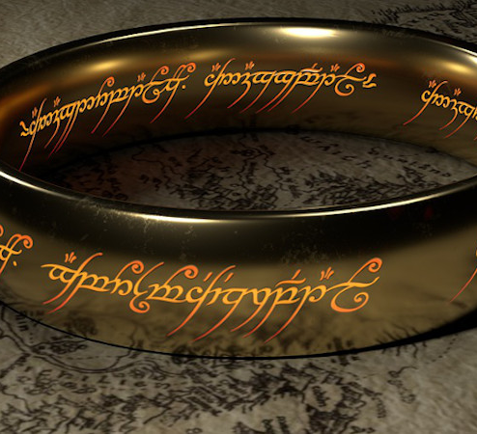
One Fear To Rule Them All
Fear of the unknown is becoming more prominent in our lives as we experience a high amount of change in our:
Work lives
Home lives
Society
Carleton, N. (2016). Fear of the Unknown: One fear to rule them all?
Notes:
RAPID AND CONSTANT CHANGE
Our world is RAPIDLY CHANGING and, even if NOT ALL but a lot of change is ultimately for the BETTER, it can be OVERWHELMING and FATIGUING
We are seeing BURNOUT INCREASE as the demands and EXPECTATIONS of change TAKE A TOLL on our HEALTH, and that includes for us as change practitioners or advocates of change
STATE OF SURVIVAL, RULED BY OUR FEARS
We can find ourselves in a STATE of SURVIVAL where we FEEL RULED by our FEARS,
and one fear in particular seems to be GETTING THE BEST OF US
This one is for all you JRR Tolkein Lord of the Rings fans out there:
The fear of the UNKNOWN has been tagged as the
ONE FEAR THAT RULES THEM ALL, the ONE FEAR THAT BINDS ALL OTHER FEARS
MAKE THE SWITCH TO STATE OF THRIVING
So how do we in our work-lives and personal lives overcome this fear brought on by constant change and SWITCH to a STATE of THRIVING?
Before we get into answering that…..

Slide 4
What 3 changes are most impacting you right now?
Please complete the anonymous survey
Go to www.menti.com and use the code 8310 0380
Notes:
THINK OF 3 CHANGES
…I’d like you to think of 3 changes that are impacting you right now that you WANT to do some REFLECTION on and have some CONVERSATION around with others
CATEGORIES
If you go to Menti there are some change categories listed –
I’d like to know. What are types of changes most impacting this room right now.
(Provide personal examples)
We are going to come back to these as we move through today’s material

Slide 5
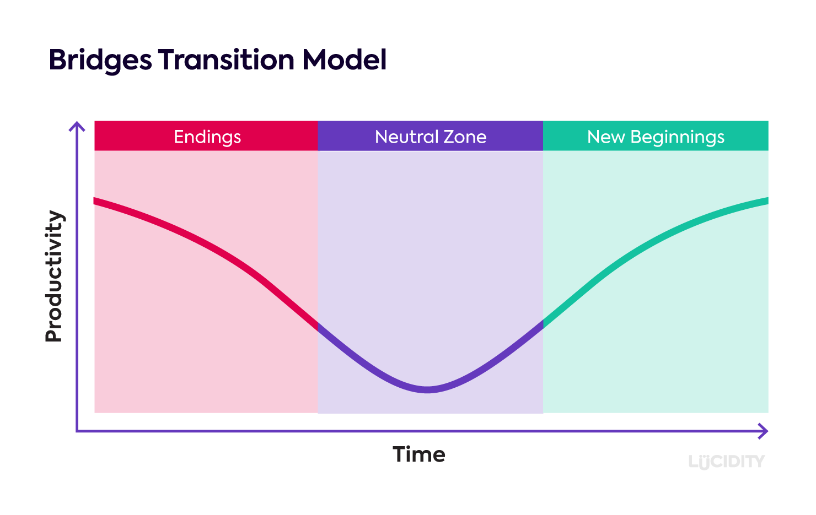
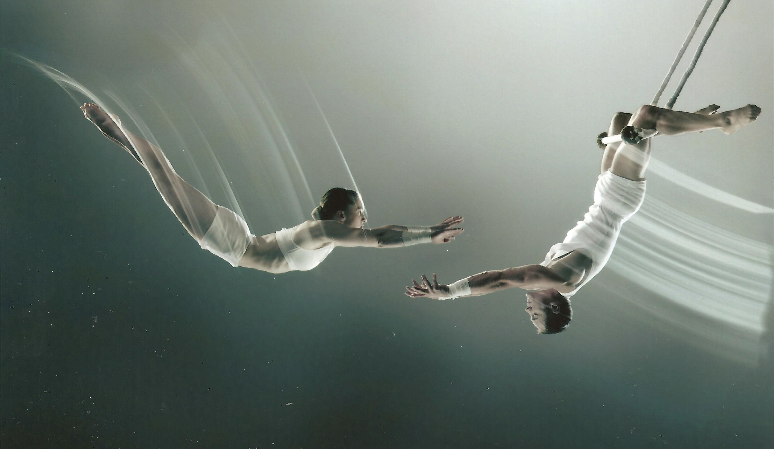
In The Neutral Zone
“It’s not so much that we’re afraid of change or so in love with the old ways, but it’s that place in between that we fear….It’s like being between trapezes. It’s Linus when his blanket is in the dryer. There’s nothing to hold on to.” – Marilyn Ferguson, American Futurist
  Bridges, W. (2003). Managing Transitions, Making the Most of Change. 2nd ed.
Notes:
WHY FATIGUED BY CHANGE
I think we can all agree and probably are already talking about with our clients how constant change is the new norm
But WHY is it that we become so FATIGUED by it?
INTRODUCE BRIDGES TRANSITION MODEL
One of the models that has helped me to understand this is called ‘The transition model’ by William Bridges
What this model THEORIZES is that when we are transitioning through a change we MOVE through 3 WAVES
ENDING
It starts with something ending
(Look at a change and what was ending in that example)
THE NEUTRAL ZONE
In the neutral zone, we are constantly EXPERIENCING that FEAR OF THE UNKNOWN
The OLD WAY has been DISCARDED and the NEW WAY is still being LEARNED
You see this DIP in the visual because in this zone is where we often see a DIP in our ENERGY, PRODUCTIVITY and EMOTIONS
(click) TRAPEZE BARS METAPHOR
I like to use this METAPHOR of being IN-BETWEEN TRAPEZE BARS
When things END you need to RELEASE your grip on the OLD BAR
And you find yourself HURTLING ACROSS SPACE INTO THE VOID OF UNKNOWING
Until you can grab onto that new bar…
….The third zone called…
NEW BEGINNINGS where we are back in our COMFORT ZONES
But while we are in that VOID it can be very FRIGHTENING and TIRING
MULTIPLE CHANGES
But what makes this process even more fatiguing is that we aren’t ever just going through one change.
We all have dozens of changes happening to us and around us all the time.
SO HOW CAN WE MAKE THIS NEUTRAL ZONE EASIER?

Slide 6
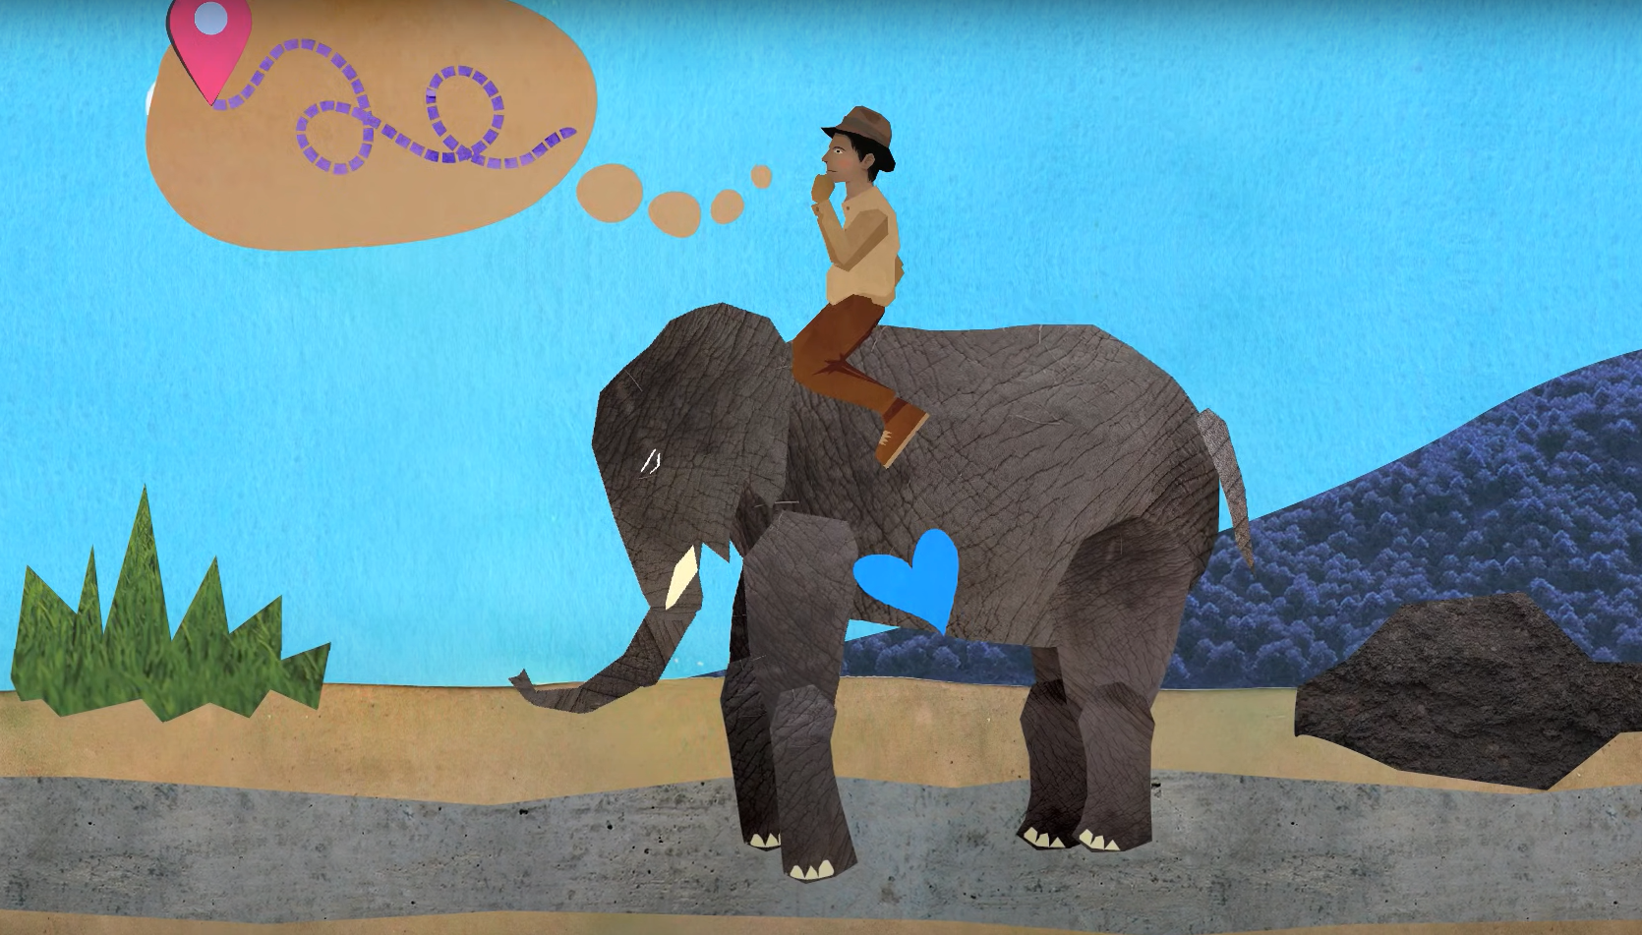
Making the Transition Easier
Heath, C., & Heath, D. (2010). Switch: How to change things when change is hard.
Notes:
INTRODUCE AUTHORS AND BOOK
The authors Chip and Dan Heath have some suggestions for how we can NAVIGATE this ZONE a little better
In their book called ‘Switch: How to change things when change is hard’ they introduce us to some ideas to help us navigate constant change
They suggest that YOU NEED TO MAKE A SWITCH.
That there are things that you CAN DO to start THINKING and ACTING DIFFERENTLY during these transitions
All it takes sometimes are these LITTLE SWITCHES to NOT let FEAR of the unknown RULE us as much
Watch video: https://www.youtube.com/watch?v=X9KP8uiGZTs&list=PLAdDYdehNTNycbBC9aX6XZln5uJFQc5pv&index=11

Slide 7
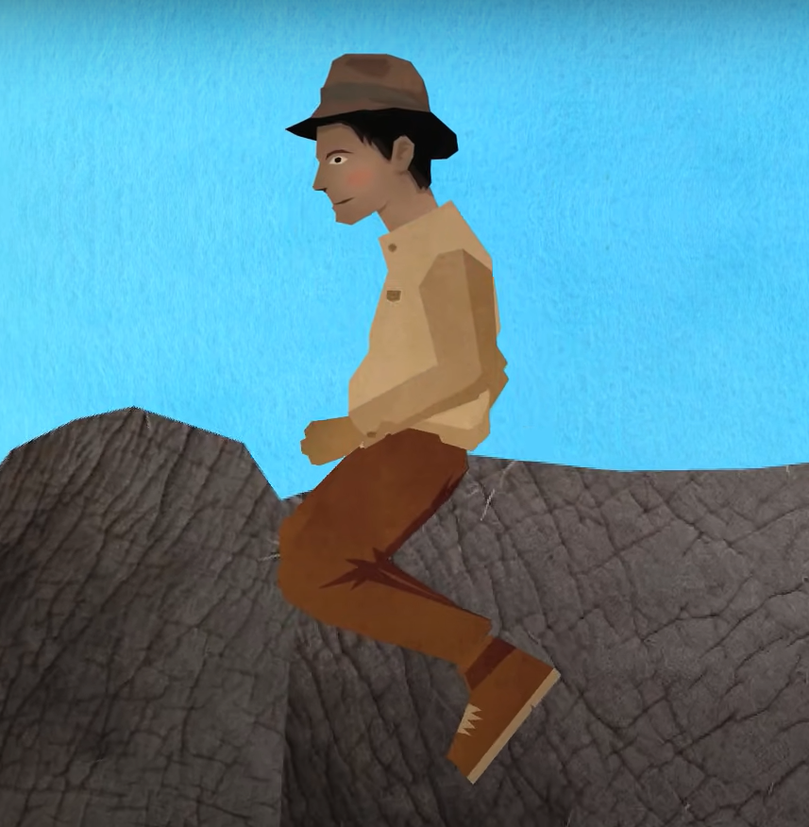
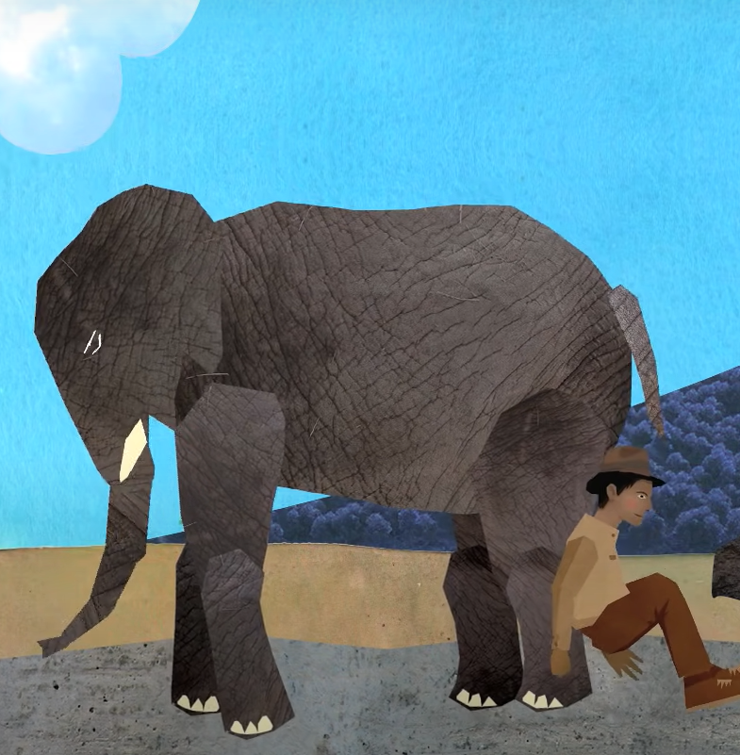
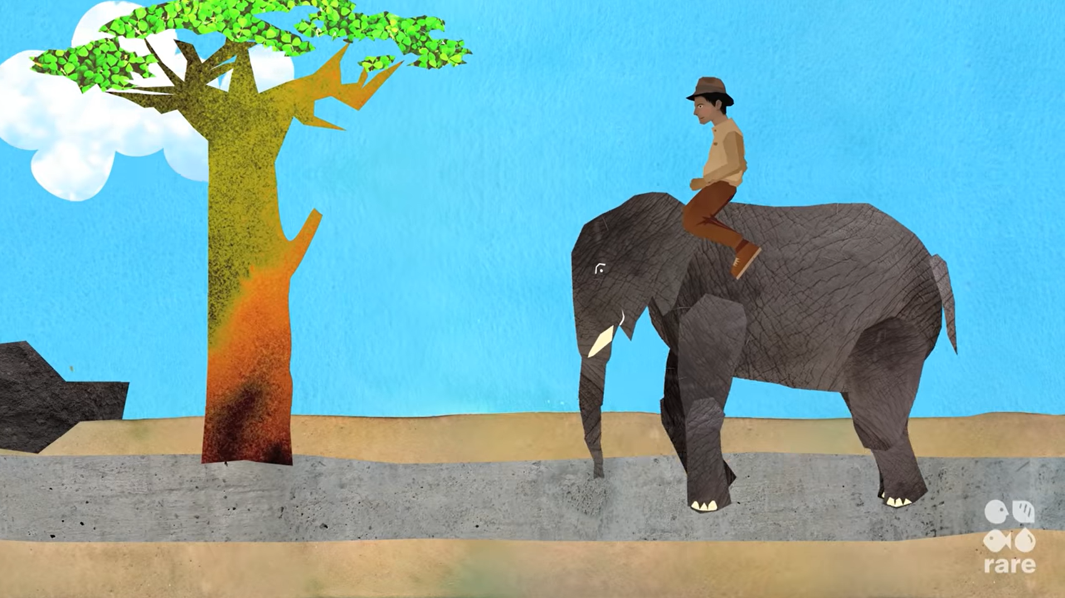
Where Do You Get Stuck?
Directing the rider
Motivating the elephant
Shaping the path
Notes:
“If you want to change things, you’ve got to appeal to both the rider and the elephant and shape the path for this duo.
Where do you get stuck?
BREAKOUT GROUPS
Going to offer you a chance here to unpack this a little bit with your peers. Based on what you heard, where do you seem to be getting stuck in the changes you identified earlier?
Is it directing the rider?
RATIONAL THINKING PART
The rider represents the RATIONAL THINKING part of our brain
PFC
The pre-frontal cortex
ANALYZE
It loves to contemplate and analyze information before deciding on a direction
PARALYZED
But when a rider isn’t sure exactly which direction to go, they end up leading the elephant in circles
Analysis paralysis is a common term we hear that relates to the rider
Or is it in motivating the elephant?
EMOTIONAL
This represents our emotional mind
STRESS RESPONSE
It’s also our centre for triggering the body’s stress response
Is it your EMOTIONS that GET THE BEST of you during change?
Are you perhaps constantly feeling THREATENED or NOT ENERGIZED?
Or is it the path?
ENVIRONMENT
This represents the environment / the SITUATION
Even when the rider and the elephant cooperate, the path must be there for them
Yet, what we can often find is that there are many OBSTACLES on the path

Slide 8
The Rider
Our brains:
Become paralyzed by choice
Are biased towards negativity
What looks like resistance is usually a lack of clarity and direction.
Notes:
We are going to take a DEEPER DIVE into what is HAPPENING to these parts of our BRAIN during change, and for each of the rider, elephant and the path I’m going to offer you 3 TACTICS to help overcome those brain barriers
ENCOURAGE TO TAKE NOTES, ESPECIALLY ON THE TACTICS YOU ARE MOST INTERESTED IN EXPLORING FURTHER BECAUSE AFTER I GO THROUGH THESE STRATEGIES you are going to get a chance to pick to work in a group that examines RIDER, ELEPHANT OR PATH STRATEGIES and see how you can apply them for your changes
WEAKNESS TO OVER-ANALYZE
The Rider’s weakness is the tendency to over analyze things
WHEN the rider is UNCERTAIN of the path, the Elephant will pick up on this
DRIVING EXAMPLE
It’s like when you are driving, you can always tell when the driver ahead of you is uncertain of where the are going – they keep switching lanes, slowing down, pick up speed – there’s CLEAR SIGNALS
ELEPHANT WILL CHOOSE IF RIDER DOESN’T
Your ELEPHANT PICK UP on these signals and it’s GOING TO MAKE ITS OWN CHOICE
It’s going to choose the DEFAULT
The behaviour we have taken in the PAST that is EASIEST
OR the behaviour that is our natural response to STRESS (FIGHT, FLIGHT, FREEZE)
1. SO MUCH CHOICE = PARALYZED
The problem we have today is that our world has produced so much choice that we can become paralyzed by it
Too many options renders us too cognitively overwhelmed and disables our rider
GROCERY STORE EXAMPLE
Have you ever noticed how shopping is a lot more tired than other types of light activity?
Just think about how many times in the grocery store you become paralyzed by the choices
2. TENDENCY TO FOCUS ON THE NEGATIVE
And then there’s our tendency to focus on the negative
We can become PARALYZED BY THE PROBLEM
Many of us can DEFAULT to being OVERLY CRITICAL – Looking at what’s not working and trying to fix it, rather than examining what is working and trying to amplify it
The good news is there are a number of switches that we can make to overcome the negativity bias and choice paralysis
https://medium.com/@guilhermelazzari/too-many-options-paralyze-us-why-we-are-all-victims-of-the-paradox-of-choice-d4bf63cd86fe
Optional:
In the Paradox of Choice Barry Schwartz shares with us that the official dogma of all western industrial societies is the belief that, in order to maximize welfare, we have to maximize freedom. We think that the best way to ensure freedom is to maximize the number of choices.
That notion is so rooted in our culture that it doesn’t occur to us to question it.
Take portable technology. Although we’re blessed with the possibility to work remotely, that also means we must decide whether to be working or not at every moment of our day.

Slide 9
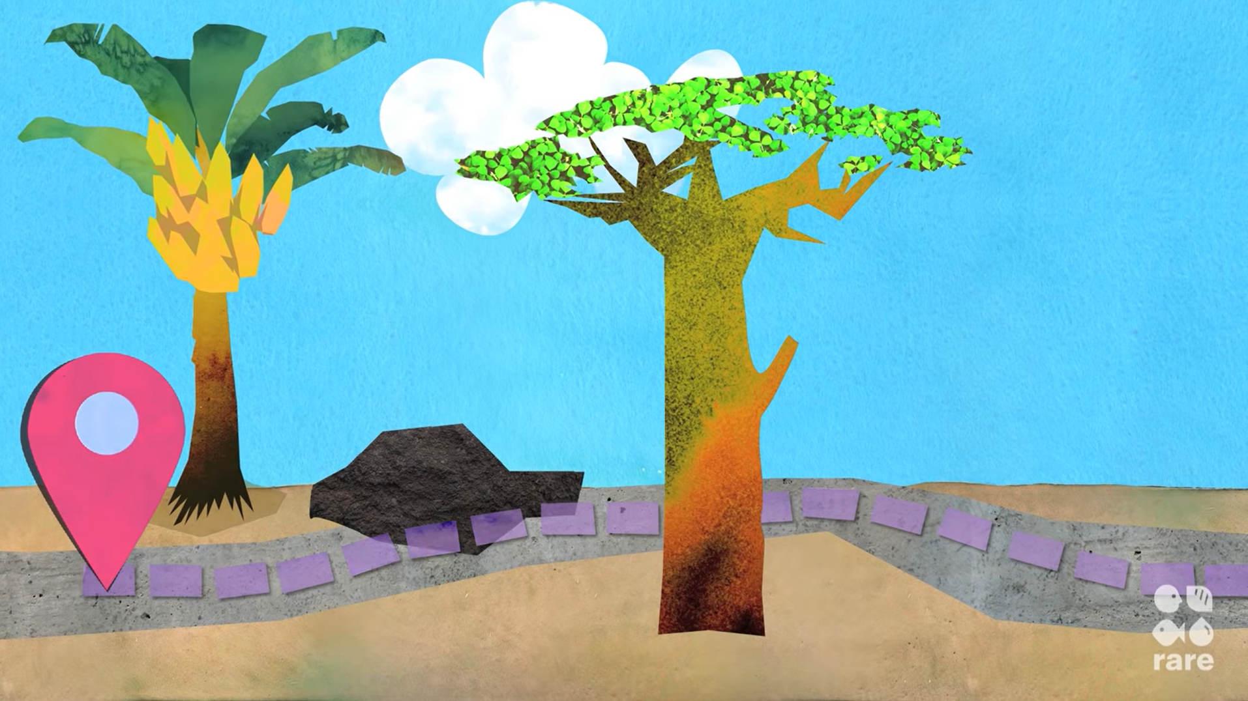



Directing The Rider
To make a switch:
Provide crystal clear direction
Find the bright spots
Create a destination postcard
Script the critical moves
Notes:
One of those options is to:
1. Find the bright spots
What’s WORKING and how can we do MORE of it?
PERSONAL EXAMPLE
I have found this really helpful personally, especially WHEN I’m feeling overwhelmed or fatigued by change
FOCUS ON A STRENGTH
When I find myself in these moments it has really helped me to sometimes focus on something that is going well, a strength, and thinking about how I can fan the strength or magnify the success
Another switch is to:
2. Create a destination postcard
WHERE is it that you WANT TO GO
Can you create that PICTURE in your mind of the FUTURE that shows WHAT COULD BE POSSIBLE?
It sends us the signal that no matter what happens in the day, we should be heading in the direction of that destination
(PROVIDE EXAMPLES IN CHAT OR SHOUT OUTLOUD)
Think of some organizations or people that have created a clear and compelling picture of where they are going
E.g. SpaceX: Enabling people to live on other planets (Jetson like future postcard)
E.g. Kennedy's vision statement is very clear, audacious, and compelling: I believe that this nation should commit itself to achieving the goal, before this decade is out, of landing a man on the moon and returning him safely to the Earth
What happens when we point to an attractive destination is that the rider starts APPLYING their STRENGTHS to FIGURE OUT HOW TO GET THERE
It gives us FOCUS and DIRECTION
Lastly, there’s:
3. Scripting the critical moves
IN THE DETAILS
Creating a compelling vision is important, but it’s not enough…………because the HARD part of change is in the DETAILS….all those options
OPTIONS PARALYZE
MORE OPTIONS, even good ones, can PARALYZE us
SIMPLIFY CHOICES
We have to simplify choices, and one of the ways we can do that is by SCRIPTING THE CRITICAL MOVES
We have to TRANSLATE those AMBIGUOUS GOALS into CONCRETE BEHAVIOURS
EXAMPLE OF CONCRETE BEHAVIOURS
If your goal is to fit into the beautiful garment you purchased for your cousins wedding, then you got to set some moves for how you are going to do that
For example, here’s a FUN FACT: Did you know that one glass of whole milk has the same amount of saturated fat as eating 5 pieces of bacon?
By scripting a move to change your behaviour when you go to the grocery store to ONLY BUY SKIM MILK you are eliminating that choice paralysis and getting closer to your goal

Slide 10
Making A Switch Practice #1
Directing The Rider
How can you remove some of the ambiguity from the change and provide crystal clear direction?
What action are you going to commit to next?
Notes:
Let’s practice making a switch
Take one of the changes you reflected on earlier
And MAKE A CHOICE right now
How can you REMOVE some of the AMBIGUITY from the change?
FIND THE BRIGHT SPOTS
Can you focus on an aspect that’s working rather than on the problem?
DESTINATION POSTCARD
Can you clarify your destination?
SCRIPT THE CRITICAL MOVES
Or map out the key steps on your journey to that destination?
(If time allows: Share story of being paralyzed by choice and how to put it all together if time allows)

Slide 11
The Elephant
Our brains are:
Hypervigilant to threats
Wired to seek the quick pay off (ice cream) over the long-term gain (being fit)
Averse to loss
Notes:
FORGET ABOUT THE ELEPHANT
Often times in change we spend so much time on directing the rider, we forget about the elephant
WEIGHT ADVANTAGE
But as we heard in the video, the elephant has a major WEIGHT ADVANTAGE to the rider
EXAMPLES OF ELEPHANT OVERPOWERING RIDER:
Most of us are all too familiar with situations where our 6-ton elephant overpowers our rider:
(PROVIDE SOME EXAMPLES IN THE CHAT OR SHOUT OUTLOUD)
What are some examples of times our elephant has overpowered our rider?
Just think of all of the times you have slept in, overeaten, dialed up your ex at midnight, procrastinated, tried quitting something and failed, skipped the gym, overreacted to something, abandoned something you were working on
NO ONE IS KEEPING SCORE
Good thing no one is keeping score right?
CAN’T KEEP ELEPHANT ON ROAD
CHANGES OFTEN FAIL because we CAN’T KEEP the ELEPHANT on the ROAD for long enough to reach the destination.
There are a few reasons for this.
1. Hypervigilance to Threats
The elephant represents the part of our brains that PERCEIVE THREATS
Which can at times be a blessing and a curse
This older part of our brain served us really well when there were lots of physical threats in our environments
- For example, if we needed to run from or fight off a tiger
But it’s not always so well suited to social threats, which is a lot of what we see in today’s changes
2. We are also wired to seek out instant gratification
The elephant represents the part of our brains that perceive REWARDS….
….BUT mostly QUICK REWARDS…..the quicker the payoff the better
The problem is that CHANGES often require that we make SHORT-TERM SACRIFICES for the LONG TERM PAYOFF
Lastly
3. We are also wired to AVOID LOSS
EXAMPLE OF WINNING $50
For example winning $50 is experienced as a mildly good thing, but losing $50 is experienced as a horrible catastrophe
The fact that we EXPERIENCE LOSS MORE SEVERLY than GAINS may cause us to BEHAVE IRRATIONALLY
PREVENTING us from taking even WELL-CALCULATED RISKS
So in summary
SNUFFLEUPAUGUS
I know that many of us would like to think that our elephants as resembling the cute, caring, curious snuffleupagus from Sesame Street
Unfortunately, this is not the default
Our default elephants are more like…well, I think this sums it up well:
(Click and watch video)
https://www.youtube.com/watch?v=MixNh9L7G5M
Our elephants can often be like every Joe Pesci character he has ever played
It is easily SPOOKED, STUBBORN, QUICKLY DEMORALIZED AND THREATENED, and DIFFICULT to actively direct.
But there is good news
There are some things you can do to motivate the elephant
To make it less spooked, stubborn, and negative
I like to think of it as food
Often what we miss is that we don’t feed our elephant, we don’t give our elephant the energy to move
So what can be sources of food for the elephant?
How can we motivate the elephant?

Slide 12
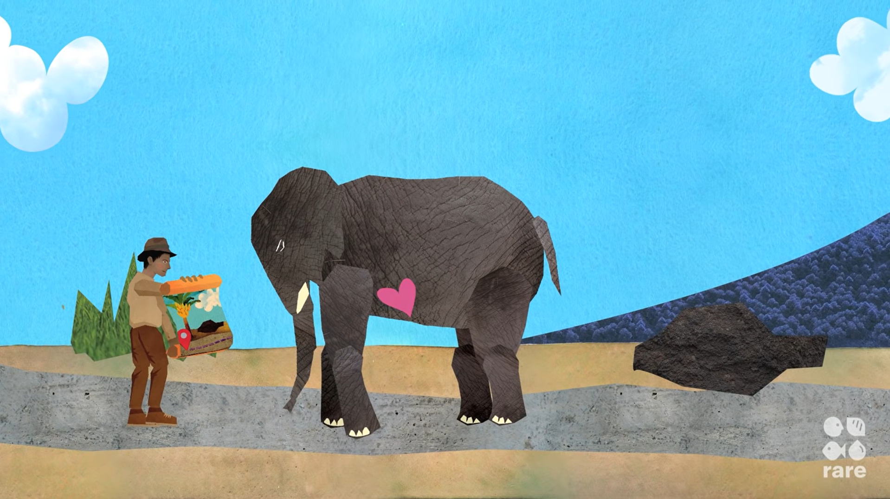



Motivating The Elephant
To make a switch:
Feel the need for change
Find the feeling (flip the script)
Reward yourself
Shrink the change
Notes:
1. Find the feeling:
Chip and Dan Heath highlight in their book that you DON’T’ NEED to KNOW to ACT, you need to FEEL to act
(SHARE IN THE CHAT OR OUTLOUD)
What feelings can motivate action?
FEAR/NEGATIVE EMOTIONS
These are what Martin Seligman refers to as a STONE IN THE SHOE SITUATION….
”If you have a stone in your shoe, it hurts and you’ll fix the problem.”
Negative emotions are ENGINEERED to produce NARROWING SHARP FOCUSED ACTIONS (fight, flight, freeze)
The challenge is today that rarely do today’s changes have this sharpened focus
Instead we live in a VUCA world – a volatile, uncertain, complex, and ambiguous world
POSITIVE EMOTIONS
We need positive emotions
Positive emotions are designed to BROADEN AND BUILD our repertoire of thoughts and actions
EXAMPLE OF PLAY and EMOTION OF JOY
Take play for example: The emotion of joy makes us want to play.
We become willing to fool around, invent new activities, learn to fail and try again.
To SOLVE VUCA problems, we need to ENCOURAGE OPEN MINDS, CREATIVITY AND HOPE
FLIP THE SCRIPT
And one of the ways you can do this is by flipping the script to what you GAINED
PROS AND CONS
It’s like evaluating the pros and cons….our brains can very easily search for and find all those cons, but we need to put more effort into evaluating those pros
Ultimately you want to be answering the question of WHY it is worth it to change: WIIFM?
Next, there’s
2. Reward yourself
Here we can USE our BRAINS CHEMISTRY to our ADVANTAGE –
GO AHEAD, REWARD YOURSELF (have that ice cream, chocolate or coffee)… but only AFTER you complete whatever action is needed
TIMING is everything
You want your brain to make an ASSOCIATION of that ACTION with the REWARD.
And OVER TIME that action will get EASIER
It’s the classic ‘Pavlovian dogs’
We CAN train our brains to respond differently
Another thing we can do is….
3. Shrink the change
Recall that our elephants are easily SPOOKED, DEMORALIZED and DERAILED
And for that reason it needs REASSURANCE, even for the very first step of the journey
A BUSINESS CLICHÉ suggests that we need always be RAISING THE BAR,
but that’s exactly the WRONG INSTINCT IF you want to motivate the reluctant elephant – you actually need to LOWER THE BAR
EXAMPLE OF LOYALTY CARD
Think about the next time you are at your favourite local coffee shop
You pick up a loyalty reward card and the server gives you three stamps instead of 1 to get you started
….that makes you feel amazing
So start looking for those two or three stamps that you already have
Make yourself feel like you AREN’T AT THE BEGINNING of your journey
You are CLOSER TO THE FINISH LINE than you think

Slide 13
Making A Switch Practice #2
Motivating The Elephant
How can you feel the need for change? How will you feed and avoid spooking your elephant?
What action are you going to commit to next?
Notes:
How can you feel the need for change? How will you feed and avoid spooking your elephant?
Are there any incentives and gains for you in the change?
FIND THE FEELING - What’s going to give you hope and inspiration?
REWARD - How can you reward yourself for the steps you are taking?
SHRINK THE CHANGE - And how can you shrink the change? Lower the bar….make it more accessible
(If time allows, provide example of putting it all together)

Slide 14
The Path
Our brains are:
Are wired to maintain the status quo
Become tired when creating new neural pathways (what looks like laziness is often exhaustion)
What looks like a people problem is often a situation problem.
Notes:
The last piece to learn here is that MOTIVATION DOESN’T WORK FOR THE LONG-TERM
WILLPOWER is an EXHAUSTIBLE RESOURCE
You can feed the elephant, but eventually the elephant is going to RUN OUT OF STEAM
And when we run out of steam we can often SLIP BACK into our OLD COMFORTABLE routines
This is what is referred to as STATUS QUO BIAS:
We are HARD-WIRED to KEEP things the way they were before – it takes LESS ENERGY than trying to create NEW NEURAL PATHWAYS
So how can we overcome this tendency to become exhausted?
EXAMPLE OF ROLLING BOULDER UPHILL
We can spend a lot of energy trying to roll the boulder uphill
Clearly that’s going to tire us out quickly
But what if we were to change the path? Go around the hill, blow it up, maybe add some rest points on the hill
Instead of thinking that our riders or elephants need to adapt (i.e. that it’s a PEOPLE problem), some of the time we just need to change the environment (i.e. it’s actually a SITUATION problem)

Slide 15
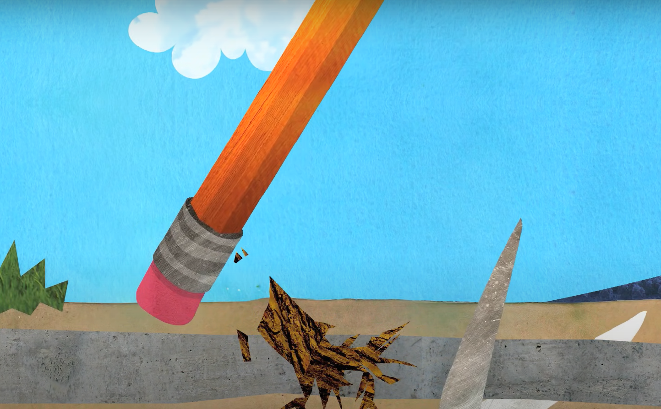
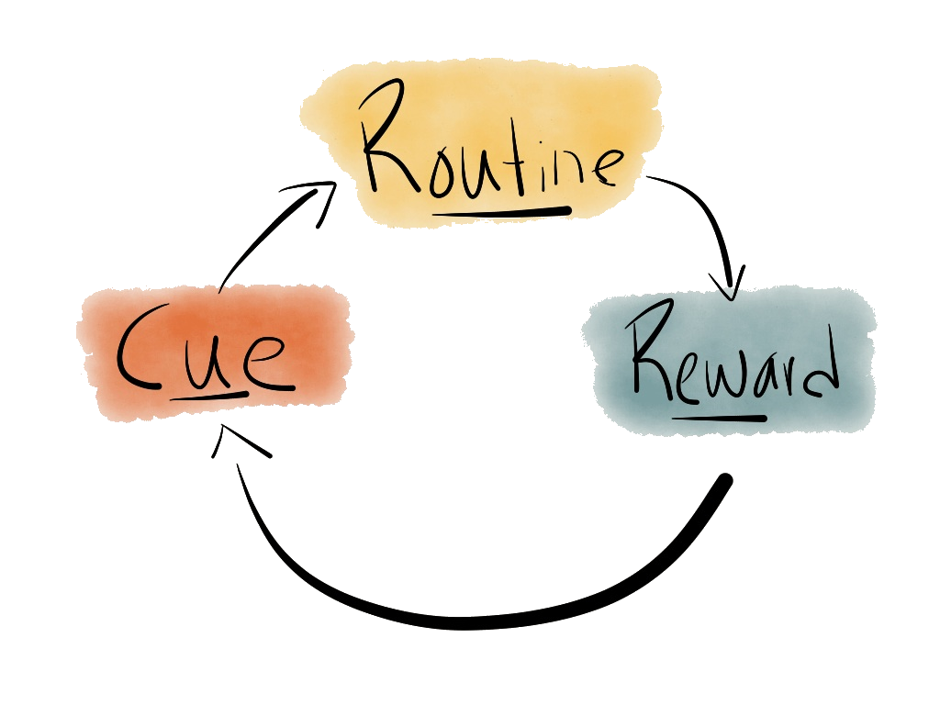



Shaping The Path
To make a switch:
Make it easier to follow the path and remove obstacles
Tweak the environment
Build habits
Rally the herd
Notes:
We can make SWITCHES so that the change FEELS EASIER for the rider and elephant
One of those switches you can do is to
1. Tweak your environment
EX. MORNING ROUTINE - ALARM CLOCK
Another example I like to provide, because this is something I struggle with every day, is how do I change my wake up patterns
Many changes I want to make in my personal life involve me having to wake up at a certain time
But getting up in the morning is really hard for me – I have no willpower first thing in the morning
One of the things I did was downloaded an app where my alarm clock requires me to take a photo of my kitchen toaster
I TOOK THE RIDER AND ELEPHANT OUT OF THE EQUATION, and adapted my environment to make it work for me
One of the interesting things about change is the MORE OFTEN we PERFORM a certain BEHAVIOUR (waking up early) the EASIER it gets
So another way we can make the path easier is by….
2. Building habits (click)
EX. LOSE WEIGHT - SMALLER PLATE
Say for example you wanted to lose weight for your cousins wedding
Tweak to your environment: smaller plate size
But how do you make that a more automatic behaviour?
We’ve already talked about the reward
But another useful tool is in CUEING UP the change you want to see
To UNLOCK THE POWER OF ROUTINE, you NEED to CONNECT the CHANGE you want to see with a PROMPT
For example
WHEN I am done cooking my meal, I will take a SMALL PLATE out
AFTER I wake up and go to take a photo of my toaster to turn off my alarm, I will meditate for 10 minutes
3. Rally the herd
SOCIAL CREATURES
Lastly, it’s important to note that we are SOCIAL CREATURES
INFLUENCE
We INFLUENCE and are influenced by those around us
SURROUND
So SURROUND yourself with the people who are DOING the change
ACCOUNTABILITY PARTNER
A really easy way to rally the herd is to find an ACCOUNTABILITY PARTNER– someone else doing the change that you can partner up with
A workout buddy
Or someone at work that you can meet with over lunch once a week that is going through a similar change to you

Slide 16
Making A Switch Practice #3
Shaping The Path
How can you make it easier to follow the path? What obstacles can you remove?
What action are you going to commit to next?
Notes:
Where can you
make TWEAKS to your environment
CUE up the change you want to see with a prompt
Or use the PEOPLE around you to HELP you change
BREAKOUT GROUPS OF 3-4 FOCUSED ON the 3 rider, elephant, or path strategies
Which do you want to explore more deeply for your particular change(s)?

Slide 17


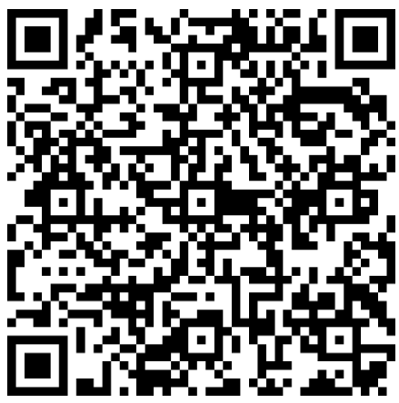
GET IN TOUCH
Use the QR code to receive:
A copy of the slides and talking points
An invitation for further dialogue on breaking through your personal, team or organizational barriers to change
Or contact me by:
E-mail: becky@querida.ca
Website: www.querida.ca
  LinkedIn: linkedin.com/in/beckyquerido/
Making a Switch: Overcoming Barriers to Change
Notes:
As we close, I wanted to bring us back to the METAPHOR OF THE TRAPEZE and leave you with some words.
This is an excerpt from The Parable of the Trapeze
By Danaan Perry
I have noticed that, in our culture, the transition zone is looked upon as a "no-thing," a noplace between places. Sure, the old trapeze bar was real, and that new one coming toward me, I hope that's real, too. But the void in between? Is that just a scary, confusing, disorienting nowhere that must be gotten through as fast and as unconsciously as possible?
NO! What a wasted opportunity that would be. I have a sneaking suspicion that the transition zone is the only real thing and the bars are illusions we dream up to avoid the void where the real change, the real growth, occurs for us. Whether or not my hunch is true, it remains that the transition zones in our lives are incredibly rich places. They should be honored, even savored. Yes, with all the pain and fear and feelings of being out of control that can accompany transitions, they are still the most alive, most growth-filled, passionate, expansive moments in our lives.
So, transformation of fear may have nothing to do with making fear go away, but rather with giving ourselves permission to "hang out" in the transition between trapezes…allowing ourselves to dwell in the only place where change really happens. It can be terrifying. It can also be enlightening in the true sense of the word. Hurtling through the void, we just may learn how to fly.
https://franmckendree.com/album/1438696/the-parable-of-the-trapeze-or-the-fear-of-transformation

Slide 18
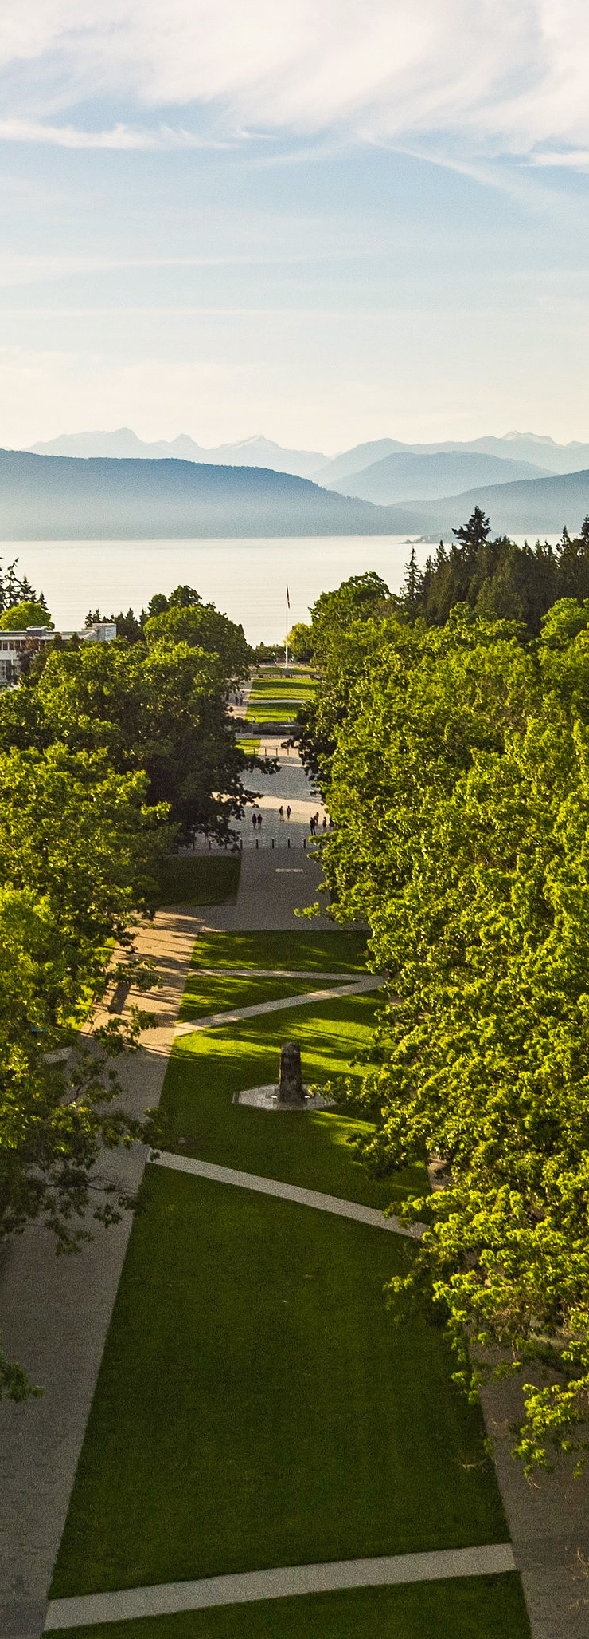

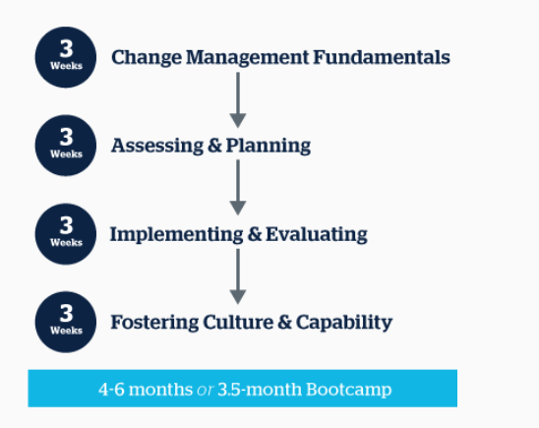
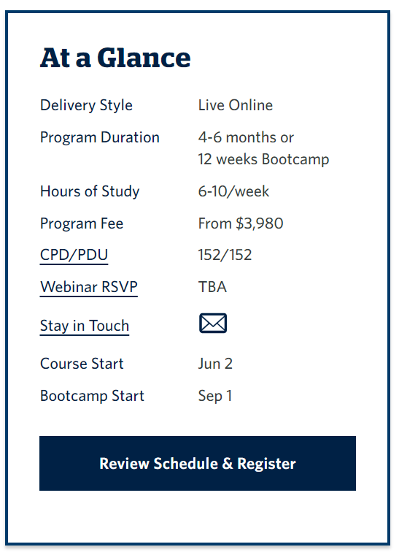

Certificate in Change Management
Find out more at www.sauder.ubc.ca/cbs-cm
Notes:
This event is part of our annual learning series that we put on to create local dialogue around trends in our profession and that align with our theme of REINVIGORATION
As part of your ACMP membership you get access to these learning events, plus other perks
Such as this one offered by our UBC partners:
If you were thinking about wanting to become a CCMP or wanting to earn some education credits, UBC offers ACMP members a 10% discount for their certificate course in change management
We also have discount options available through our Prosci partners, so you can reach out to me in both cases if you were interested in getting a discount

Slide 19
What’s one word that sums up your experience from today?
Please complete the anonymous survey
Go to www.menti.com and use the code 8310 0380

Slide 20

Resources
Chip and Dan Health, Switch: How to change things when change is hard (2010)
William Bridges, Managing Transitions: Making the Most of Change, 2nd ed. (2003)
BJ Fogg, Tiny Habits: The small changes that change everything (2020)
Danaan Perry, Warriors of the Heart, “The Parable of the Trapeze” (1997)
Daniel J. Levitin, The Organized Mind: Thinking Straight in the Age of Information Overload (2014)
Video and pictures clips: behavior.rare.org/
Bonus: woopmylife.org/
Notes:
“24 Cognitive Biases that are warping your perception of reality”
https://www.weforum.org/agenda/2018/12/24-cognitive-biases-that-are-warping-your-perception-of-reality/
https://dansilvestre.com/switch-book/
https://www.sciencedirect.com/science/article/pii/S0887618516300469
https://hrexecutive.com/burnout-is-continuing-to-rise-is-hr-doing-enough/

